Slide 1
Becoming an anti-racist team: leadership support for the journey
Henrietta, Yvonne, Iesha, Daniel, Mo, Simon, Janchai, Sophie, Marina, Hugh, Theodora
Leicester, Barnet, Harrow, Wandsworth
Notes:
Before we begin we would like to take the opportunity to thank everyone who has contributed to putting this conference together from the services in Leicester

Slide 2
Becoming anti-racist matters because…
Black women are 5 times more likely to die in pregnancy than White women.

Slide 3
Becoming anti-racist matters because…
Black Caribbean and mixed White/Black Caribbean pupils are 3-4 times more likely to be affected by school behaviour policies and exclusions than their White counterparts.

Slide 4
Becoming anti-racist matters because…
26.5% of Black Caribbean pupils attained level 5 or above in GCSE English and Maths compared to 42.4% of White pupils.
Notes:
DfE data 2019

Slide 5
Becoming anti-racist matters because…
Black children are over four times more likely to be arrested than White children, and they are given a custodial sentence at higher rates than White children (28% of the youth custody population).
Notes:
Despite making up 4% of the 10-17 year old population

Slide 6
Becoming anti-racist matters because…
Black people are 9.5 times more likely to be stopped and searched, and 5 times more likely to have force used on them than their White counterparts.

Slide 7
Becoming anti-racist matters because…
Black people are 4 times more likely to be detained under the Mental Health Act relative to the general population.

Slide 8
But …there is hope
“We have all the tools needed to reform our ways of thinking, fix the inequalities and end the discriminations [by] choosing empathy over hatred…humanism over tribalism…”
Elif Shafak, 2020
Notes:
HO address

Slide 9
“At the same time…we shouldn’t forget to look within, critically examine our own assumptions and hidden stereotypes, expand and soften our hearts; and as we do all that, we must go on and continue working just as others have before us”
Elif Shafak, 2020

Slide 10
Outline of the day: a collection of stories… (copies on the tables)
10:00-10:45 The story of self: grounding ourselves, connecting with the room and with our relationship to anti-racist leadership
10.45 – 12.15 The story of us: examples of journeys so far
12.15 – 1.15 Lunch
1.15-14.30 The story of us: acts of resistance and accountability
14.30-14.45 Tea/ coffee break
14.45-15.45 The story of self: Returning back to ourselves and the room for action planning
15.45-16.00 Plenary and closing remarks

Slide 11
How are we going to safely work and grow together?
Notes:
How to ensure we can all participate safely. Discuss on your tables the ‘conditions’ that will enable this. We’ll take feedback from each table – one point each and Iesha will record them on the flip chart for us.

Slide 12
If anti-racism was an entity of its own…what word comes to mind to describe your relationship to it?
Menti.com
Use code 72195256

Slide 13

Our journeys towards becoming an Anti-racist service

Slide 14

Getting started…
Notes:
The catalyst that helped get the work going …This led to the desire to take the team on a journey so we could better understand these events

Slide 15

Hopes and Dreams

Slide 16




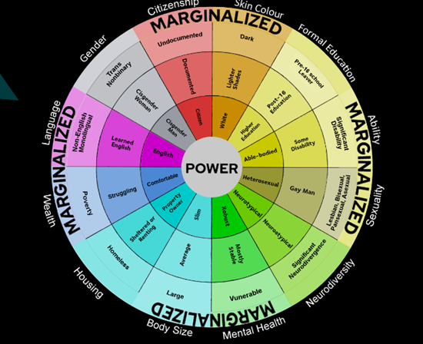
‘Change Moments’

Slide 17

Challenges - it hasn’t all been plain sailing

Slide 18

Staying strong and committed

Slide 19

Let’s celebrate!
Team received a Children’s Services award for its work
Growing bravery amongst the team to recognise, name and

Slide 20

Where next?

Slide 21

‘The Journey’
Accountability

Slide 22
Consultation
Use of team development day to consider how to make our consultation processes more culturally responsive. Culturally Responsive Practice Framework (Sakata, 2021)
Culturally safe environment – culturally sensitive verbal and non-verbal communication; communicate genuine respect and interest in cultural background and influence on identity; demystify our role; scripts and open-ended questions to create space for sharing thoughts and feelings. More time for consultations with interpreter.
Culturally related strengths - incorporation of resources to provide prompts and structure to facilitate culturally responsive consultation practice such as Cultural Assets Identifier, Tree of Change.
Cultural awareness - intersectionality; cultural models and frameworks; difference in cultural norms.

Slide 23
Assessment
Culturally responsive approach - consider socio-cultural variables including acculturation, intergenerational trauma, religion, family context and practices; cultural variables included as part of formulation and hypothesis testing.
Culturally responsive assessment project – Year 1 Tavistock TEPs Racial Justice Project spring and summer 2023 helped us reflect on assessment used frequently and why, theoretical approaches, conceptualisation of culturally responsive assessment, barriers to progress and next steps.
Culturally responsive tools – appropriateness of standardised assessment; dynamic assessment; home language assessment; culturally related strengths Cultural Assets Identifier during consultation. Dynamic assessment service development.

Slide 24
Intervention and Reports
Intervention - Integrate culturally relevant strengths; sensitive approach to potential barriers to interventions (e.g., shame, stigma); culturally appropriate therapeutic interventions (Farooq, 2019). Frame goals and outcomes in individual’s culture e.g., co-production with parents and education staff of EHC outcomes.
Reports - Incorporate culturally appropriate information into reports such as cultural characteristics (e.g., language, level of acculturation) use of translators. Culturally appropriate and accessible language; translation; consider knowledge of UK education system; differing experience of education system and need for sensitive phraseology.

Slide 25
service user feedback
Culturally Responsive Practice Framework (Sakata, 2021) to generate potential questions; team meeting small group discussion and working group discussion.
Next steps to share with service users for feedback before incorporated into service user feedback questionnaire. Scale from strongly disagree – strongly agree.
The EP created a culturally safe, sensitive and inclusive environment.
The EP showed genuine respect and interest in your cultural background and identity.

Slide 26

Transcultural Supervision (Mo):
Working together in a culturally sensitive way
(Anti-Discriminatory Practice - standing item on the Supervision agenda):
Becoming conscious of one’s own culture
Recognising that habitual ways of thinking may arise out of cultural assumptions
Seeing a supervisee’s culture is equally valid to our professional culture but may lead to holding different values and assumptions
Dialogue as it can throw up cultural clashes which offer a fruitful way to understand and negotiate cultural difference
Becoming familiar with the types and ranges of difference that may occur so we can recognise them and be sensitive
Never assuming we understand a supervisee’s cultural world and being curious and interested whilst accepting our unknowing
Soni, A., Fong, H., & Janda, T. (2021). Culturally responsive supervision: a reflective account on the value of acknowledging and working with difference within supervision. Educational and Child Psychology, 38(4), 24-34.
Anita Soni, Haley Fong & Tara Janda (2022). An exploration of two supervisors’ engagement in a transcultural supervision exercise to support culturally responsive supervision with trainee educational psychologists (TEPs), Educational Psychology in Practice, 38:2, 194-213, DOI: 10.1080/02667363.2022.2059450

Slide 27
Reflective spaces – The Wandsworth approach
How to…
Every other month- Face to face sessions on Monday morning before our service team meeting.
Ground rules established and revisited before each session
Small groups of 4-5 people, with a facilitator to support each one.
One group member volunteers to bring a case/issue which they are grappling with to the space, and chooses the Reflecting team approach they feel would be most helpful for them (e.g. standard RT, goldfish bowl, group discussion)
Round up at end of each space – “How was the space for you?”
Ending activity – projective activity where individuals pick an object or picture (available in the room) which represents how they feel about the session and discuss reason for choice with neighbour.

Slide 28
Reflective spaces – The Wandsworth approach
Brave Conversations Prompts for Facilitators
The proportion of Black children who end up in the inclusion room
The high levels of behaviour points that are attributed to children from minoritised groups
Noticing how other children are being more harshly disciplined compared to their White counterparts
Cultural assumptions that are being made which are based on negativity or ‘pigeonholing’
Cultural expectations of how others should interact e.g. giving signs of respect through eye contact
Assumptions of parents from Black or other minoritised groups being ‘fiery’ or troublesome, and suggesting that this explains the CYP’s behaviour/presentation.
Less compassion for a young person’s trauma and assumptions being made around their behaviour; it is ‘within child’ or intrinsic to them.
The language used by staff when talking about Black children or children from minoritised backgrounds – how to challenge this
Observing the difference in teacher feedback given to pupils depending on their ethnicity

Slide 29
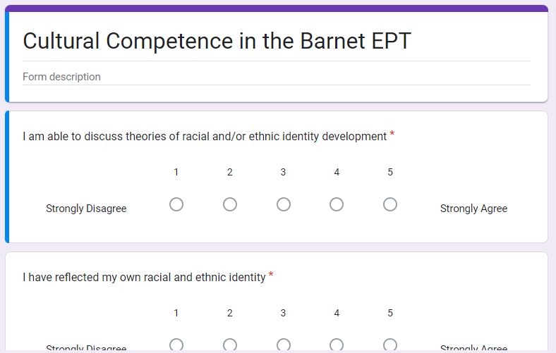
Evaluating cultural competence in the EPT (Munoz, 2009), Anderson (2020)

Slide 30
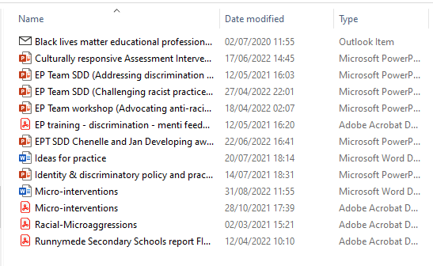
CPD

Slide 31
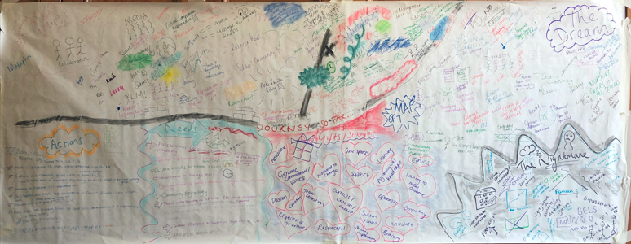

Slide 32
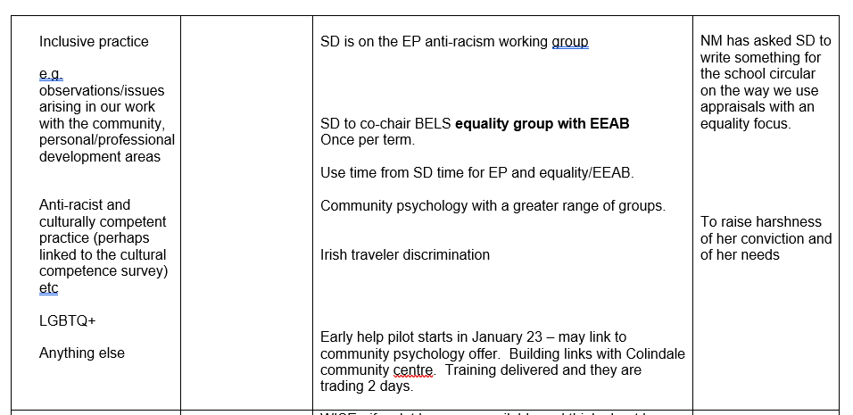
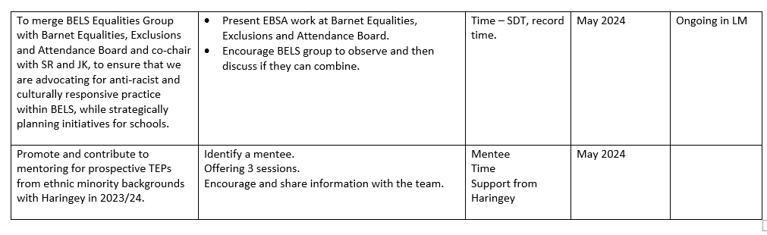
Line Management and Appraisal

Slide 33
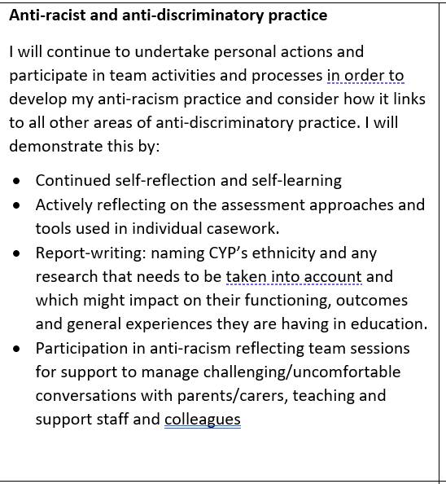
Line management and Appraisal
Wandsworth SCPS Appraisal Form 2023-24

Slide 34
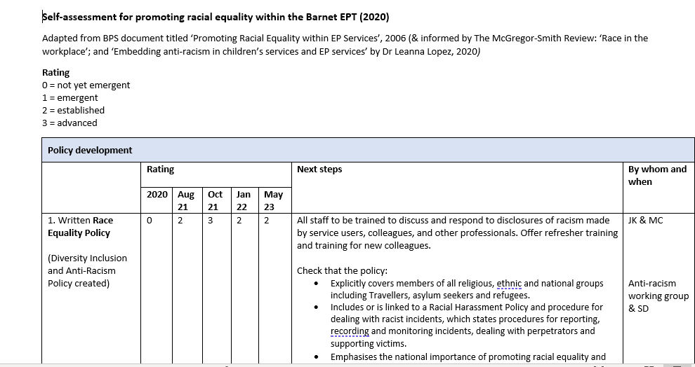

Slide 35
Policies
Galvanising function - Anti-racist policy development as a whole service extended process to develop vision as a service, new identity and cemented commitment to anti-racist practice.
Process - Working group drew upon policies used by other services and personalised to represent our service. Draft discussed at team development day, working group and finalised at team meeting.
Rooted our service development and a live point of reference – underpinned service development; induction pack and shared in supervision, not inactive sitting on a shelf. Next branch is to develop supervision policy to ensure that it is fit for purpose.

Slide 36
Policies
Harrow Educational Psychology Service
Equality, Diversity, Inclusion and Anti-Racism Policy
The Harrow Educational Psychology Service is committed to promoting diversity, inclusion and anti-racism as part of our everyday practice. We aim to ensure that the members of our team, as well as the children and young people, their families, members of staff and other professionals who access our service, are respected, valued and enabled to thrive.
As a service we have reflected on racism in general and with particular regard to anti-Black racism. We have restated our commitment to anti-racist practice. Our team continually seek to understand and constructively address issues relating to ethnicity and race, racial trauma, bias and privilege in education. We recognise the racial disparities that exist in educational outcomes and exclusions, as well as the significant impact that racial trauma and re-traumatisation has on children and young people, their families and other members of our community.

Slide 37
Policies
At Wandsworth SCPS we have decided not to create a standalone Anti-Racism Policy.
We felt that this might give the impression that anti-racism is an ‘add on’ to the other policies, and we wanted to ensure that the focus is on the promotion of anti-racist practice throughout our work, and therefore reflected across all our policies.
We are currently revising all of our service Policies, and as a key part of this process, we have asked the teams tasked with each Policy to consider this statement:
“If members of Black and global majority communities (who are marginalised) in Wandsworth were reading this policy how would they know that as a service we are working towards Becoming Anti-racist?”

Slide 38
Data: SVR monitoring using 2021 Census for Barnet
Percentage of the Barnet population:
Black 8%
Asian 18%
White 64%
Mixed / other 10%
1263 pieces of EP casework in traded schools from September 2022 – August 2023
EPT carried out 393 assessment visits in traded schools
(Data from SVR – missing one EP’s data)
EP involvement by ethnicity
Black = 163/1263 = 13%
54 assessments
Asian = 159/1263= 13%
51 assessments
White = 540/1263= 43%
172 assessments
Arab = 38/1263 = 3%
13 assessments
Eastern European 71/1263 = 6%
17Assessments
Mixed 138/1236 = 11%
41 assessments
SEMH as primary need
Involvement overall: 616/1263 = 49%
159/393 assessments = 40%
Black 68/616= 11%
19 assessments
Asian = 59/616 = 10%
10 assessments
White 313/616 = 51%
87 assessments
Arab 12/616 = 2%
4 assessments
Eastern European 24/616 = 4%
4 assessments
Mixed 79/616 = 13%
21 assessments

Slide 39
Representation on LA Boards
BELS Equalities Board (looking inwards)

Slide 40
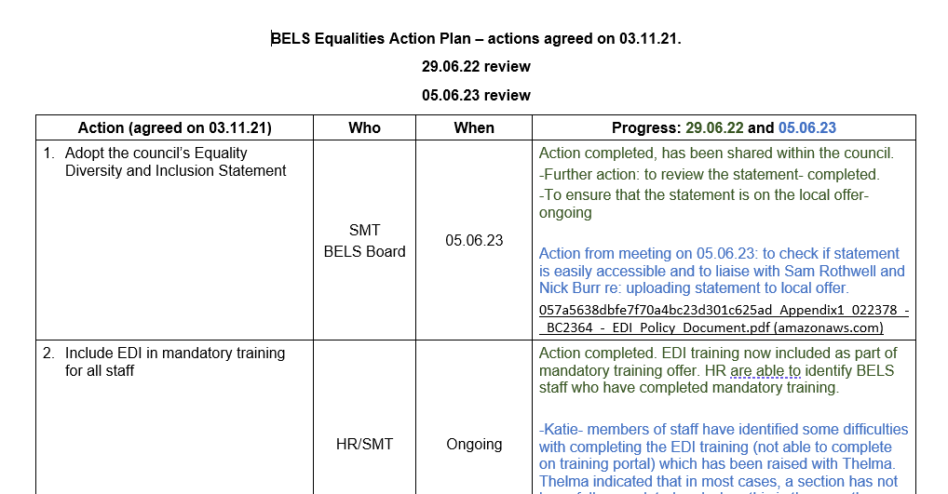
Accountability at LA level

Slide 41
EEA board
Exploring disproportionality in exclusions data
Exploring Year 6 to 7 transitions and initiatives to support transitions more robustly

Slide 42
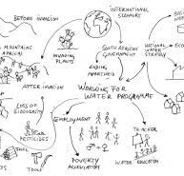
Mapping out our reflections
A rich picture helps us to understand the complexity of an entire situation. It is a way of thinking holistically. It is based on the idea that ‘a picture tells a thousand words’.
It also builds on the fact that our intuitive consciousness communicates more easily in impressions and symbols than in words.
Drawings can both evoke and record insights into a situation
Who are the stakeholders and how do they relate to the issue at hand/ topic?
Draw the relations of stakeholders to each other.
Draw the context, the causes and effects and any other relevant social, economic, political, environmental features or issues.
Make sure your drawing includes both facts and subjective information.
You can use a legend or some words to explain stakeholders or problems, but do not use too many words.

Slide 43

Drawing a close to the day…

